Slide 1

Augmented Reality Apps
The Next Gen Info Dev Deliverables
Presented @ tcworld India, 2019

Slide 2
Augmented Reality Apps
Agenda
Introduction to Augmented Reality (AR)

Slide 3
Augmented Reality Apps
Agenda
Introduction to Augmented Reality (AR)
Why AR?

Slide 4
Augmented Reality Apps
Agenda
Introduction to Augmented Reality (AR)
Why AR?
My AR journey

Slide 5
Augmented Reality Apps
Agenda
Introduction to Augmented Reality (AR)
Why AR?
My AR journey
The process and the challenges

Slide 6
Augmented Reality Apps
Agenda
Introduction to Augmented Reality (AR)
Why AR?
My AR journey
The process and the challenges
A demo

Slide 7
Augmented Reality Apps
Agenda
Introduction to Augmented Reality (AR)
Why AR?
My AR journey
The process and the challenges
A demo
The reception

Slide 8
Augmented Reality Apps
Agenda
Introduction to Augmented Reality (AR)
Why AR?
My AR journey
The process and the challenges
A demo
The reception
A quick tutorial of how to build an AR app

Slide 9


Augmented Reality
An introduction
If you have seen this
https://youtu.be/K8K_xLKG5mk

Slide 10

Augmented Reality
An introduction
If you have seen this, this,

Slide 11
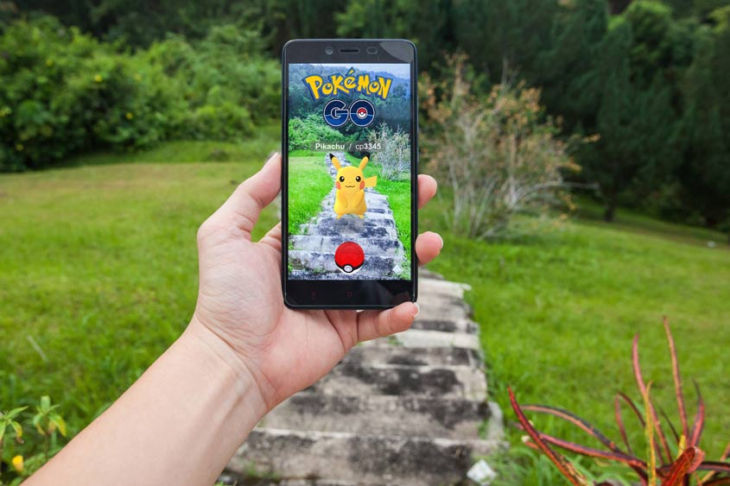
Augmented Reality
An introduction
If you have seen this, this, or this, you’ve already been touched by Augmented Reality !!!

Slide 12

Augmented Reality
An introduction
Augmented Reality is ‘augmenting’ objects in the real-world by computer generated perceptual information to provide an interactive, immersive experience.

Slide 13

Augmented Reality
An introduction
Augmented Reality is ‘augmenting’ objects in the real-world by computer generated perceptual information to provide an interactive, immersive experience.
Virtual Reality
While AR simply alters our perception of the real world environment, VR replaces it with a simulated one.

Slide 14
Augmented Reality
An introduction
Augmented Reality is ‘augmenting’ objects in the real-world by computer generated perceptual information to provide an interactive, immersive experience.
Virtual Reality
While AR simply alters our perception of the real world environment, VR replaces it with a simulated one.
AR and VR were pioneered by entertainment and gaming companies, and they are now finding adoption across industries

Slide 15
Augmented Reality
An introduction
Mobile AR, Marker-based AR, Marker-less AR

Slide 16
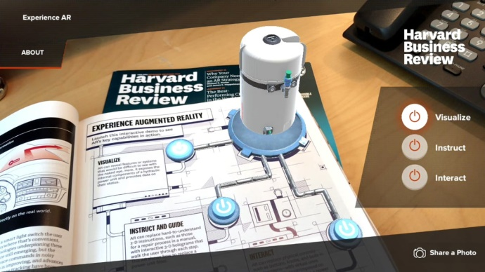
Augmented Reality
Mobile AR vs. Headset based AR
(Magic Leap & Microsoft Hololens)
In Mobile AR, mobile devices are used to scan the real environment on which digital transformation is over-laid.

Slide 17
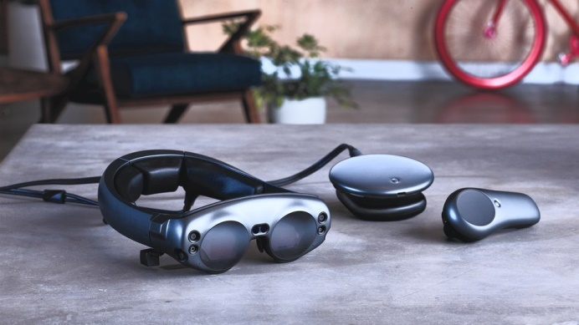
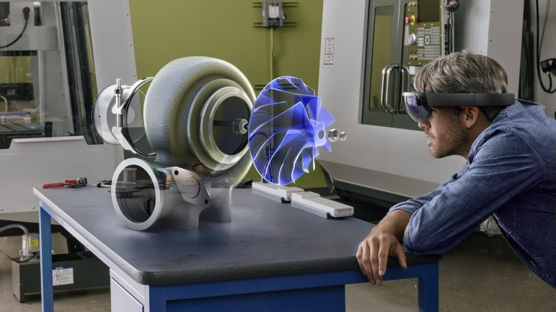
Augmented Reality
Mobile AR vs. Headset based AR
(Magic Leap & Microsoft Hololens)
In Mobile AR, mobile devices are used to scan the real environment on which digital transformation is over-laid.
Companies like Microsoft have released
Headsets which scan the real world to
over-lay digital transformation.

Slide 18
Augmented Reality
Marker-based AR vs. Marker-less AR
pioneered by Apple {IR Kit} and Google {IR Core}
Marker-based AR technology uses a marker image to orient the digital over-lay.

Slide 19
Augmented Reality
Marker-based AR vs. Marker-less AR
pioneered by Apple {IR Kit} and Google {IR Core}
Marker-based AR technology uses a marker image to orient the digital over-lay.
Marker-less AR technology is advanced enough to discard the need for a marker image and over-lay digital objects directly on to the real environment.

Slide 20
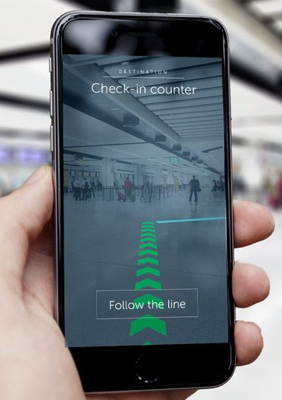
Why Augmented Reality?
Examples
The Gatwick airport passenger app enables passengers to use AR maps from their mobile phone to navigate through the airport

Slide 21
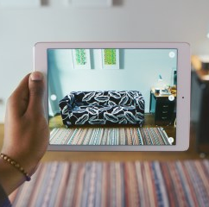
Why Augmented Reality?
Examples
With the Ikea Place app, you can scan your room and design the space by placing Ikea objects in the digital image of your room to create a new environment with the new products

Slide 22
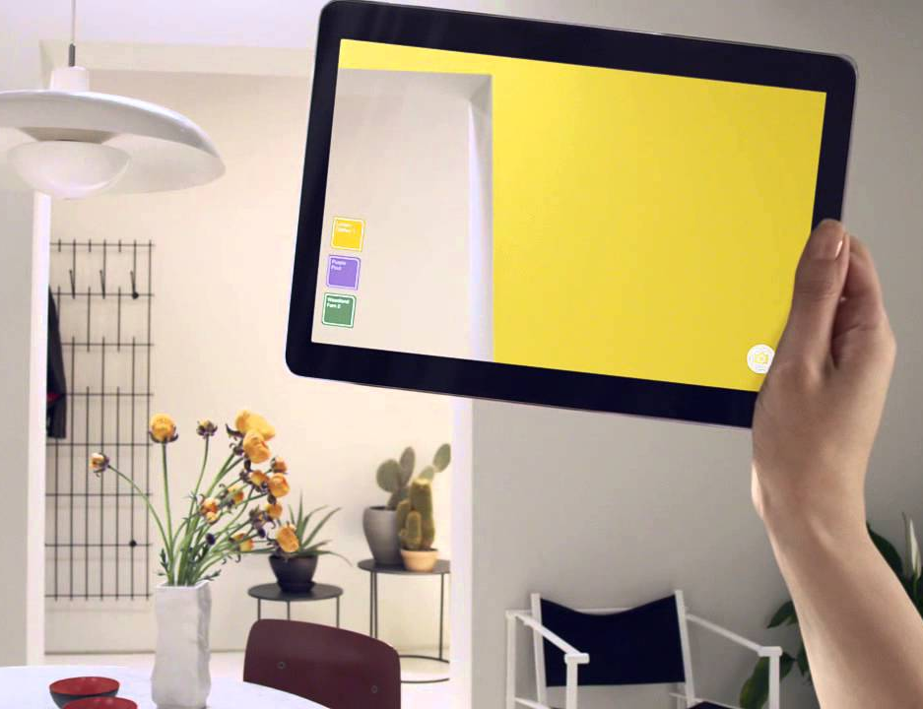
Why Augmented Reality?
Examples
The Dulux Visualiser helps you try out a shade of paint for your room before you buy

Slide 23
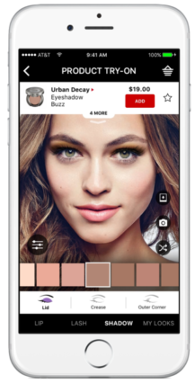
Why Augmented Reality?
Examples
With the Sephora app, you can try out different looks and eye, lips and
cheek products as well as colors right on your own digital face

Slide 24
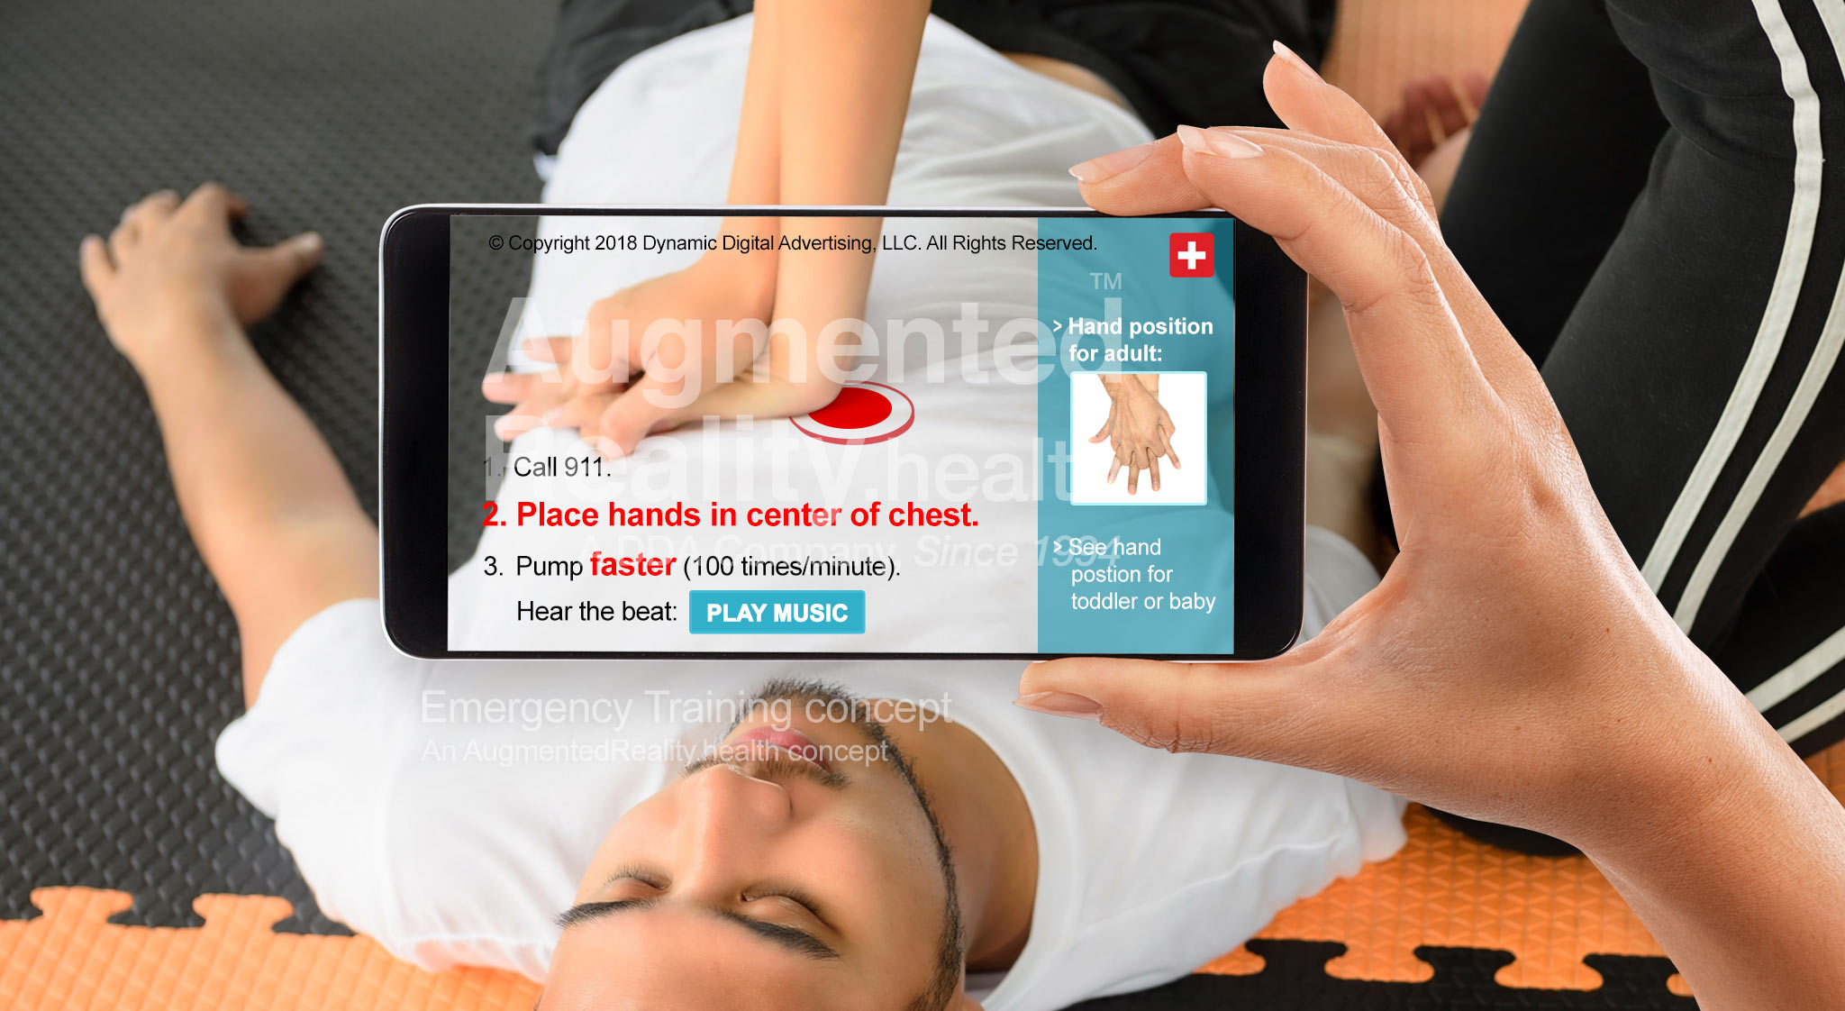
Why Augmented Reality?
Why should a Tech Writer care?
Aids training – think downloadable apps; think ‘do once, train infinitely’

Slide 25
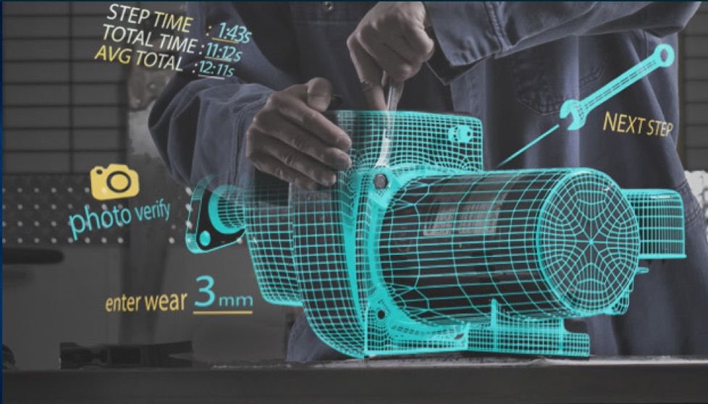
Why Augmented Reality?
Why should a Tech Writer care?
Aids training – think downloadable apps; think ‘do once, train infinitely’
Gets into the thick of the action; gets where the printed word finds it difficult to reach

Slide 26
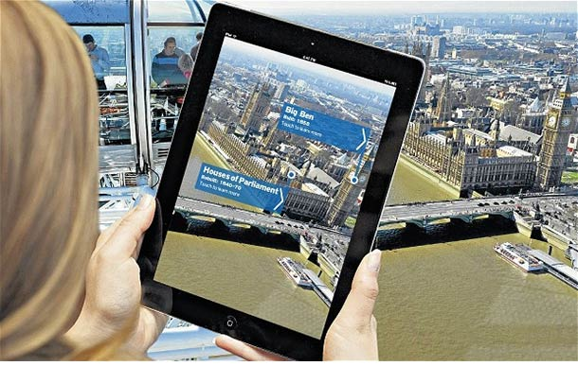
Why Augmented Reality?
Why should a Tech Writer care?
Aids training – think downloadable apps; think ‘do once, train infinitely’
Gets into the thick of the action; gets where the printed word finds it difficult to reach
Opportunity to design information; do UX design; add value

Slide 27
Why Augmented Reality?
Why should a Tech Writer care?
Aids training – think downloadable apps; think ‘do once, train infinitely’
Gets into the thick of the action; gets where the printed word finds it difficult to reach
Opportunity to design information; do UX design; add value
This is a wave, we tech writers ought to ride
‘cause it’s cool

Slide 28

My journey with augmented reality
Here’s the story of how I got hooked to AR
It all began with a document I was editing!
A hardware manual with an installation procedure had smudged images

Slide 29

My journey with augmented reality
Here’s the story of how I got hooked to AR
It all began with a document I was editing!
A hardware manual with an installation procedure had smudged images
I began by drawing high-res vector images.

Slide 30

My journey with augmented reality
Here’s the story of how I got hooked to AR
It all began with a document I was editing!
A hardware manual with an installation procedure had smudged images
I began by drawing high-res vector images.
Not content with this, I snooped around for hardware drawings that could accentuate my drawings
I ended up with a 3D model of the hardware

Slide 31




My journey with augmented reality
Here’s the story of how I got hooked to AR
I used this to create a video with screenshots of the 3D model

Slide 32
My journey with augmented reality
Here’s the story of how I got hooked to AR
Then, I stumbled upon a video of the Harvard Business Review’s Augmented Reality App.
With that as the inspiration, I set upon building our own AR app

Slide 33
My journey with augmented reality
The Process and the challenges
Finding the right project for which to build the app

Slide 34
My journey with augmented reality
The Process and the challenges
Finding the right project for which to build the app
Finding a team that could help me

Slide 35
My journey with augmented reality
The Process and the challenges
Finding the right project for which to build the app
Finding a team that could help me
Designing the marker image

Slide 36
My journey with augmented reality
The Process and the challenges
Finding the right project for which to build the app
Finding a team that could help me
Designing the marker image
Storyboarding to get the lesson right

Slide 37
My journey with augmented reality
The Process and the challenges
Finding the right project for which to build the app
Finding a team that could help me
Designing the marker image
Storyboarding to get the lesson right
Designing the app – UI features, the learning modes

Slide 38
My journey with augmented reality
The Process and the challenges
Finding the right project for which to build the app
Finding a team that could help me
Designing the marker image
Storyboarding to get the lesson right
Designing the app – UI features, the learning modes
Interacting with the design team and reviewing their progress

Slide 39
My journey with augmented reality
The Process and the challenges
Finding the right project for which to build the app
Finding a team that could help me
Designing the marker image
Storyboarding to get the lesson right
Designing the app – UI features, the learning modes
Interacting with the design team and reviewing their progress
Finally, completing the app and launching it !

Slide 40
My journey with augmented reality
The reception
The AR app was received wonderfully well by all stakeholders

Slide 41
My journey with augmented reality
The reception
The AR app was received wonderfully well by all stakeholders
Business wanted to monetize it; managers wanted it for their products

Slide 42
My journey with augmented reality
The reception
The AR app was received wonderfully well by all stakeholders
Business wanted to monetize it; managers wanted it for their products
Hardware engineers found it simple to learn and practice steps of the procedure

Slide 43
My journey with augmented reality
The reception
The AR app was received wonderfully well by all stakeholders
Business wanted to monetize it; managers wanted it for their products
Hardware engineers found it simple to learn and practice steps of the procedure
Fellow tech writers were excited with a new deliverable to the Tech Writing team’s kitty

Slide 44
Questions
Q & A
The Next Gen Info Dev Deliverables
Presented @ tcworld India, 2019

